Slide 2
i CAN
I can determine how I can best ”leave my mark”

Slide 4
DALE CHIHULY
http://www.chihuly.com/file/dale-chihuly-beyond-object

Slide 7
Wassily Kandinsky French (born Russia), 1866 - 1944

Slide 8
The Kandinsky Effect

Slide 9
Wassily Kandinsky

Slide 10
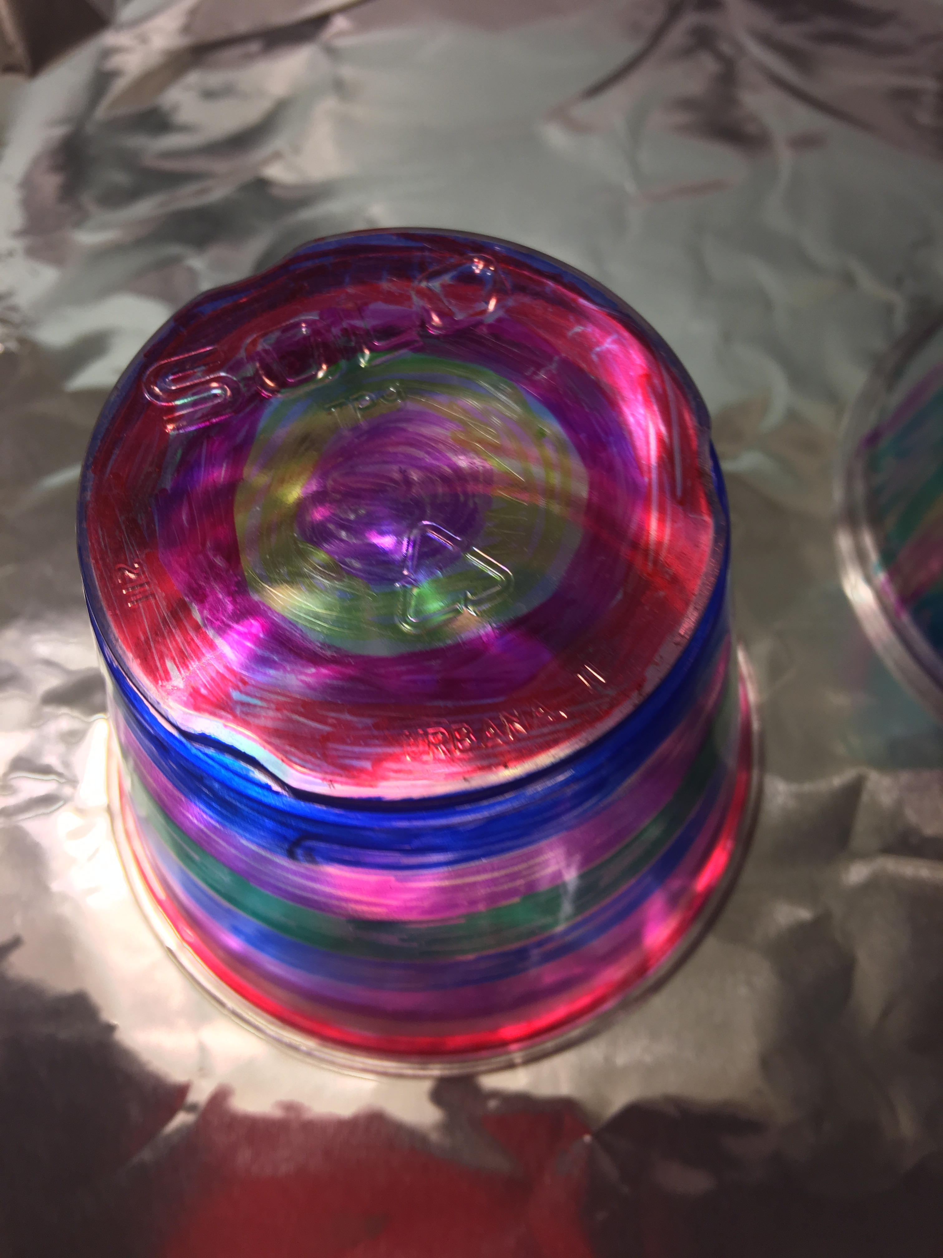
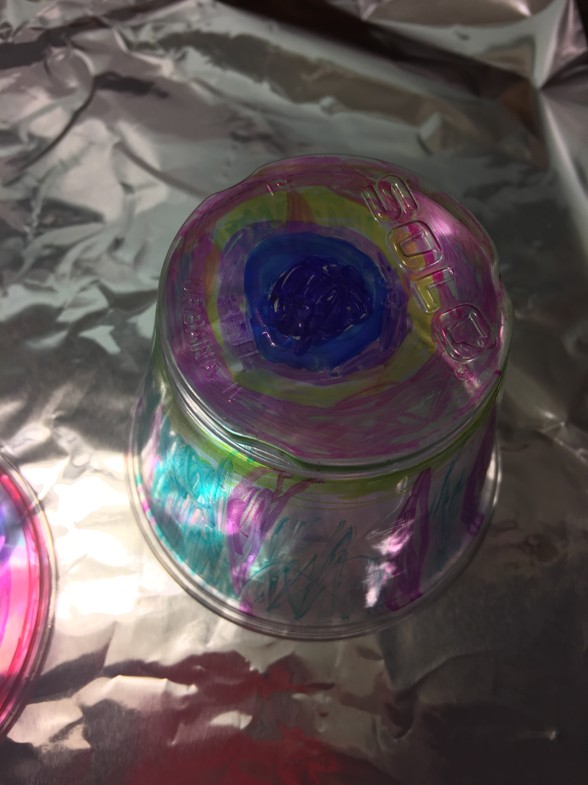
Making your Mark – Kandinsky/Chihuly Inspired Mobile

Slide 12
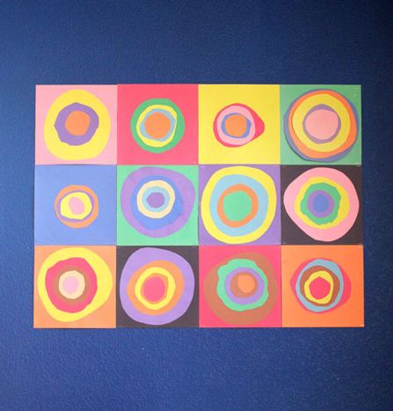
Kandinsky Inspired Collage

Slide 13
Quiver

